Slide 2
Review Tutorial 1
Session 10
MATRICES
SYSTEMS OF LINEAR EQUATIONS

Slide 3
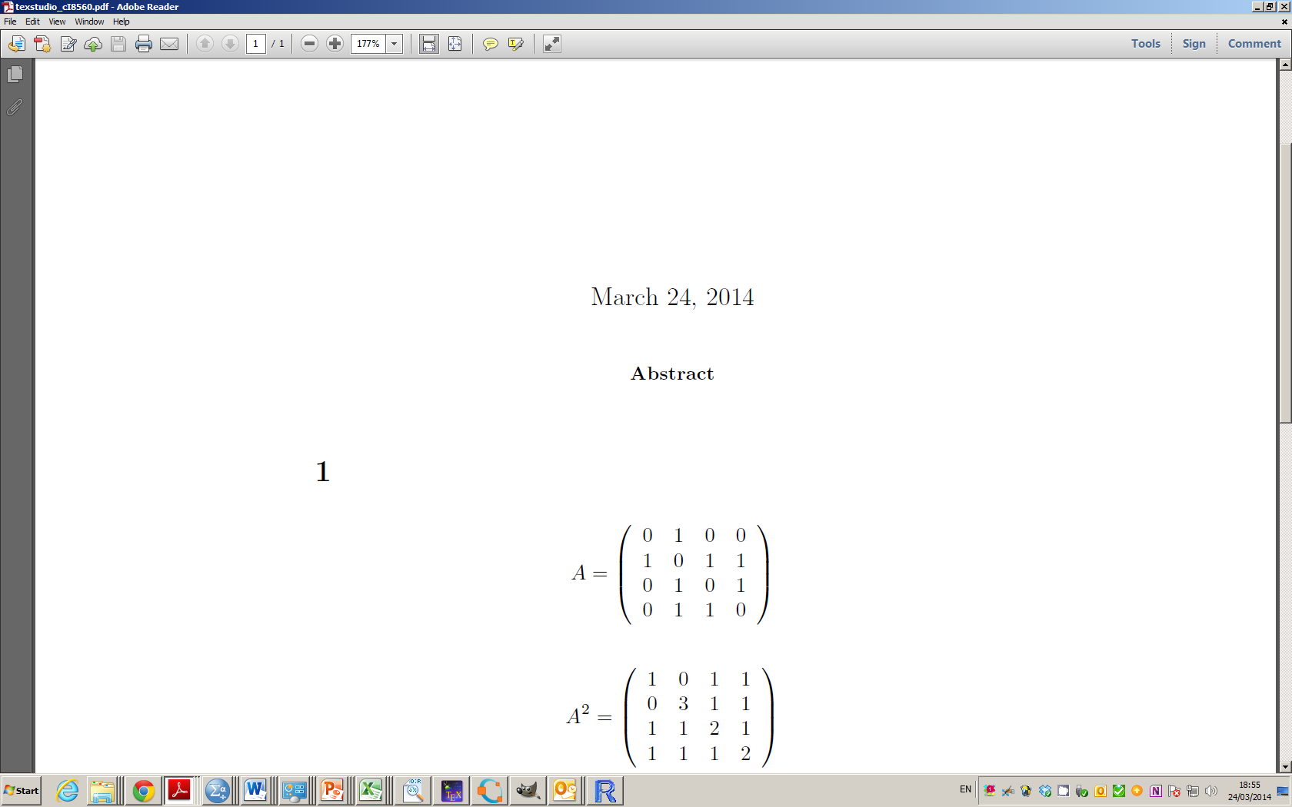
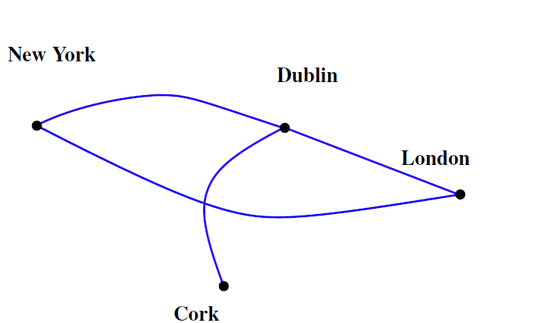
Graphs and Matrices

Slide 4
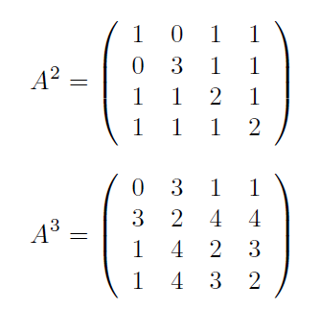
Graphs and Matrices

Slide 5
Blank Slide

Slide 6
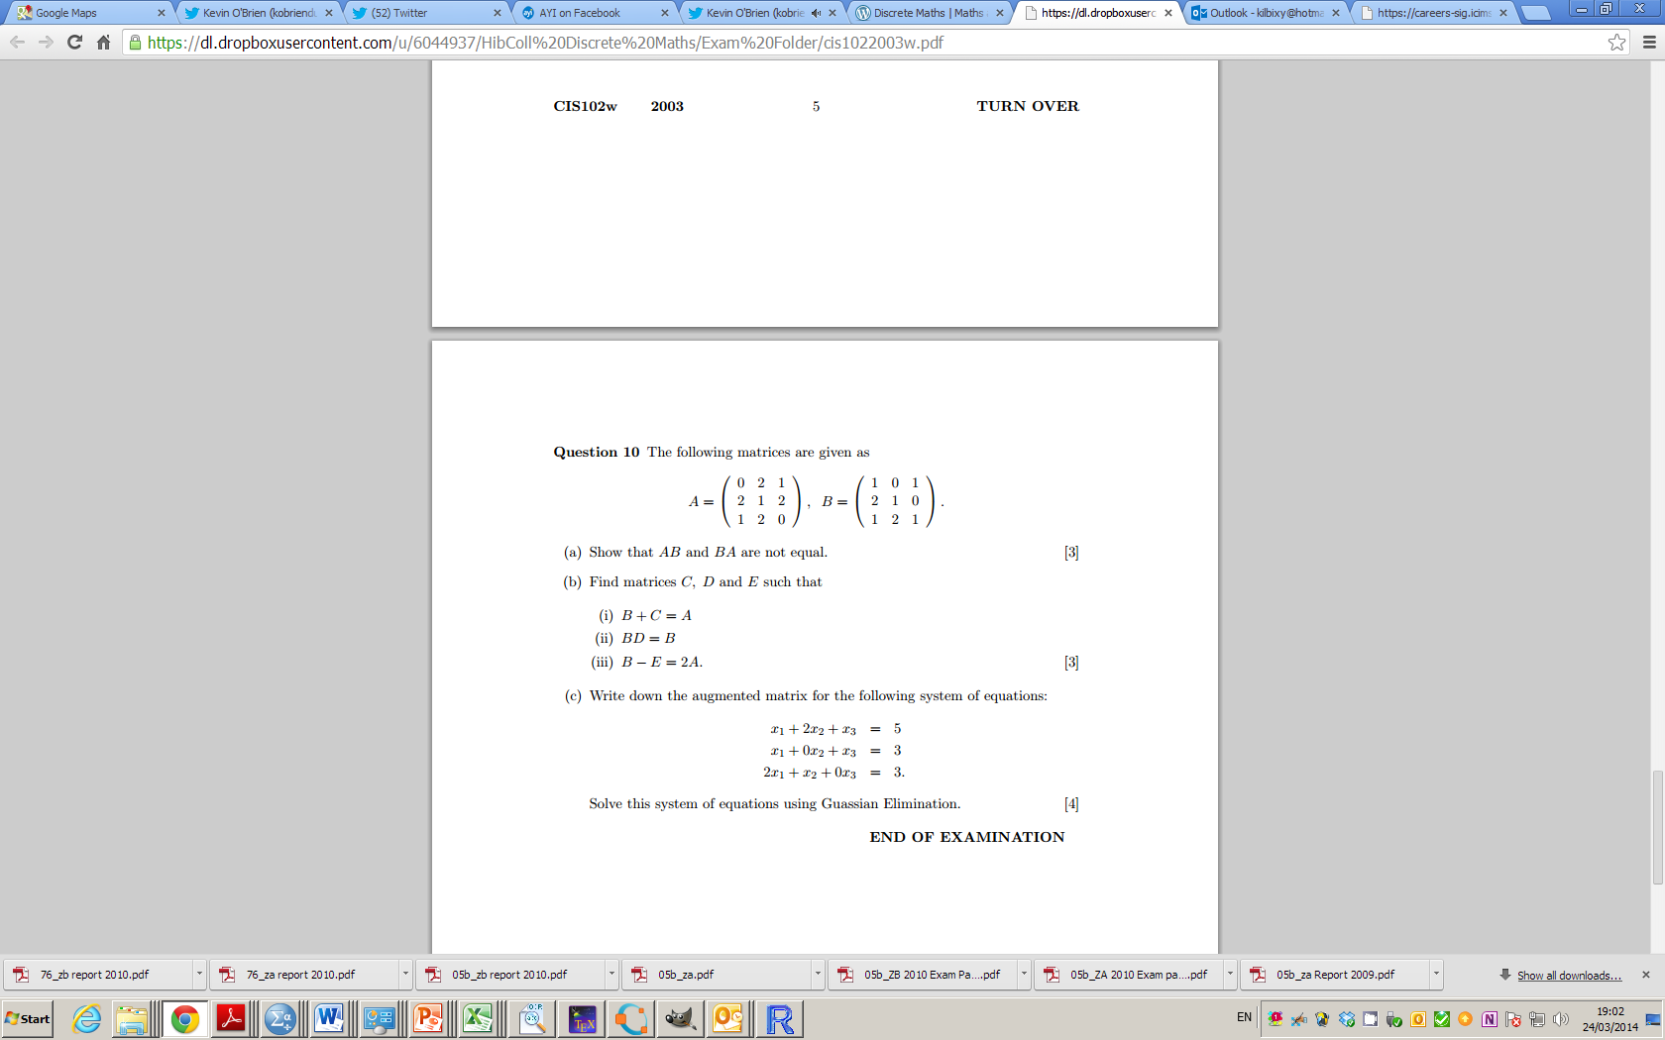
2003 Question 10

Slide 7
2003 Question 10

Slide 8
Blank Slide

Slide 9
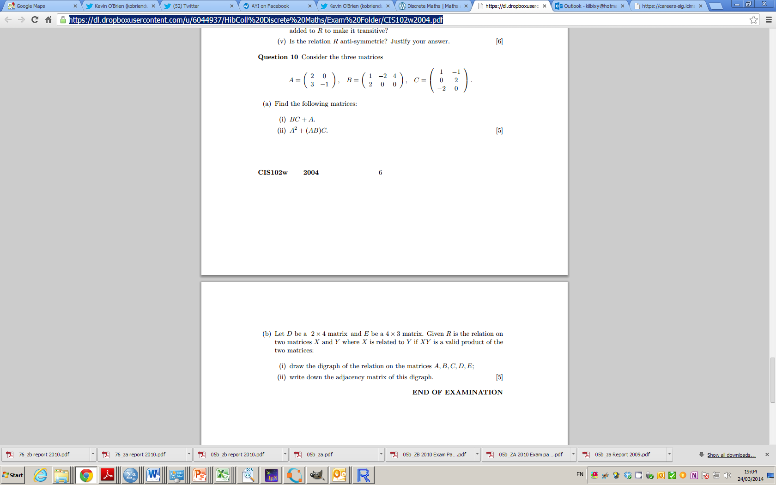
2004 Question 10

Slide 10
2004 Question 10 – Part B

Slide 11
Blank Slide

Slide 12
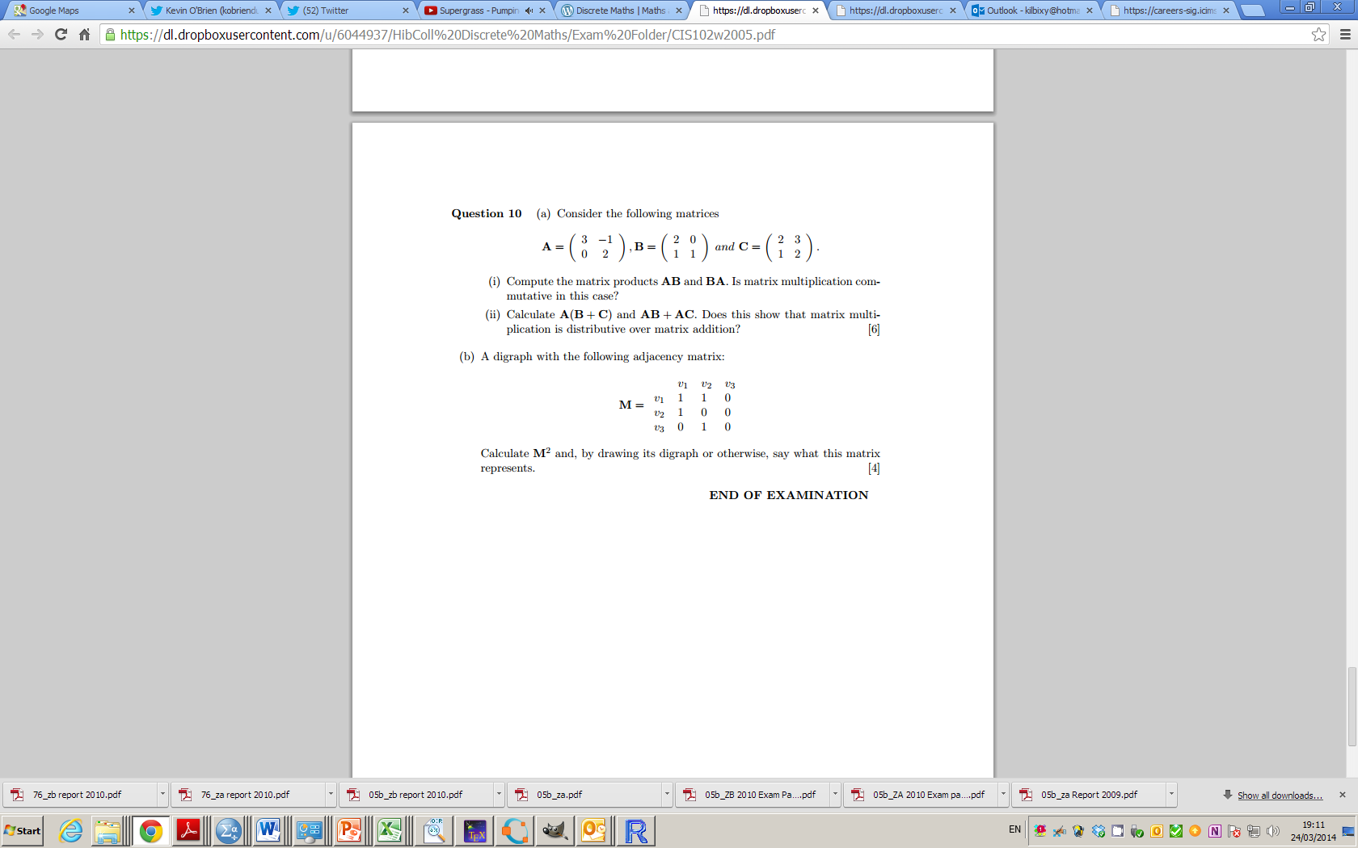
2005 Question 10

Slide 13
2005 Question 10

Slide 14
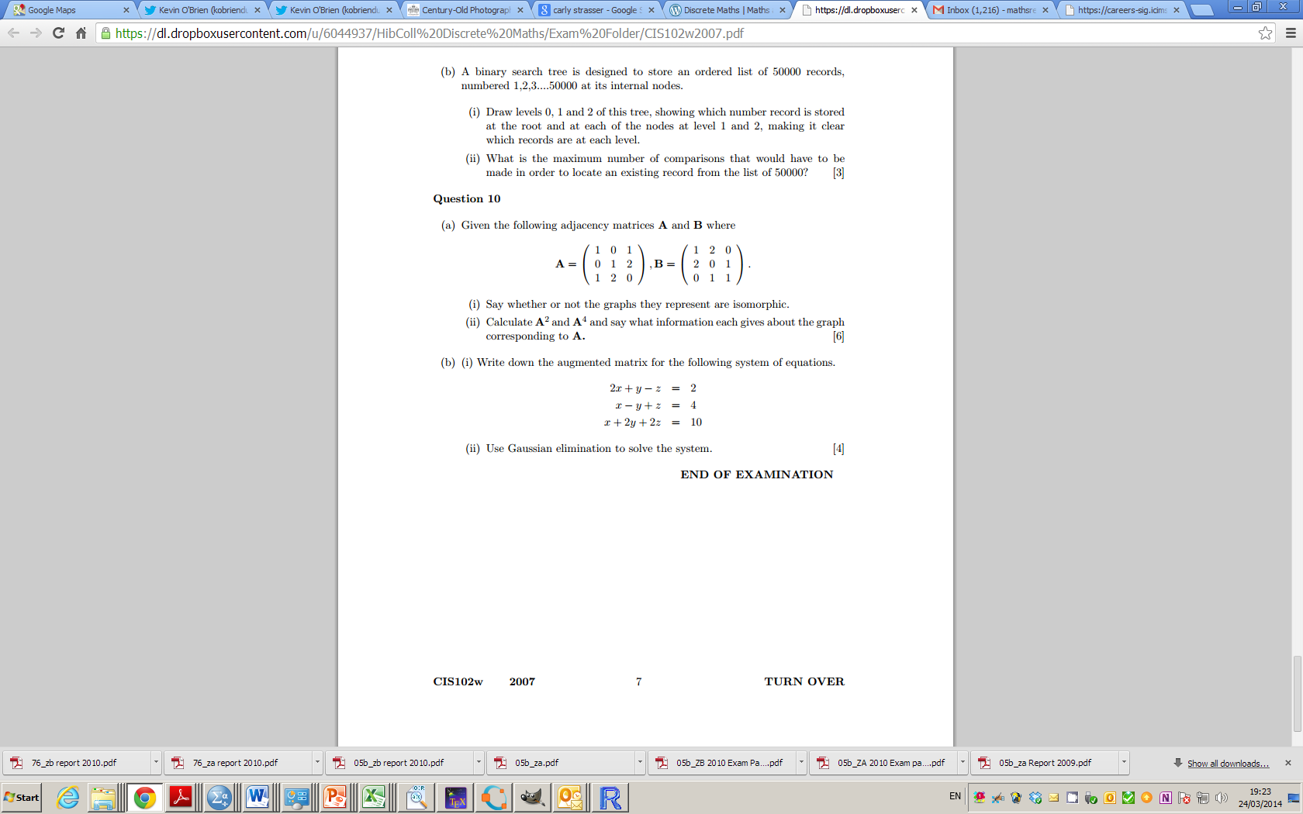
2007 Question 10

Slide 15
2007 Question 10

Slide 16
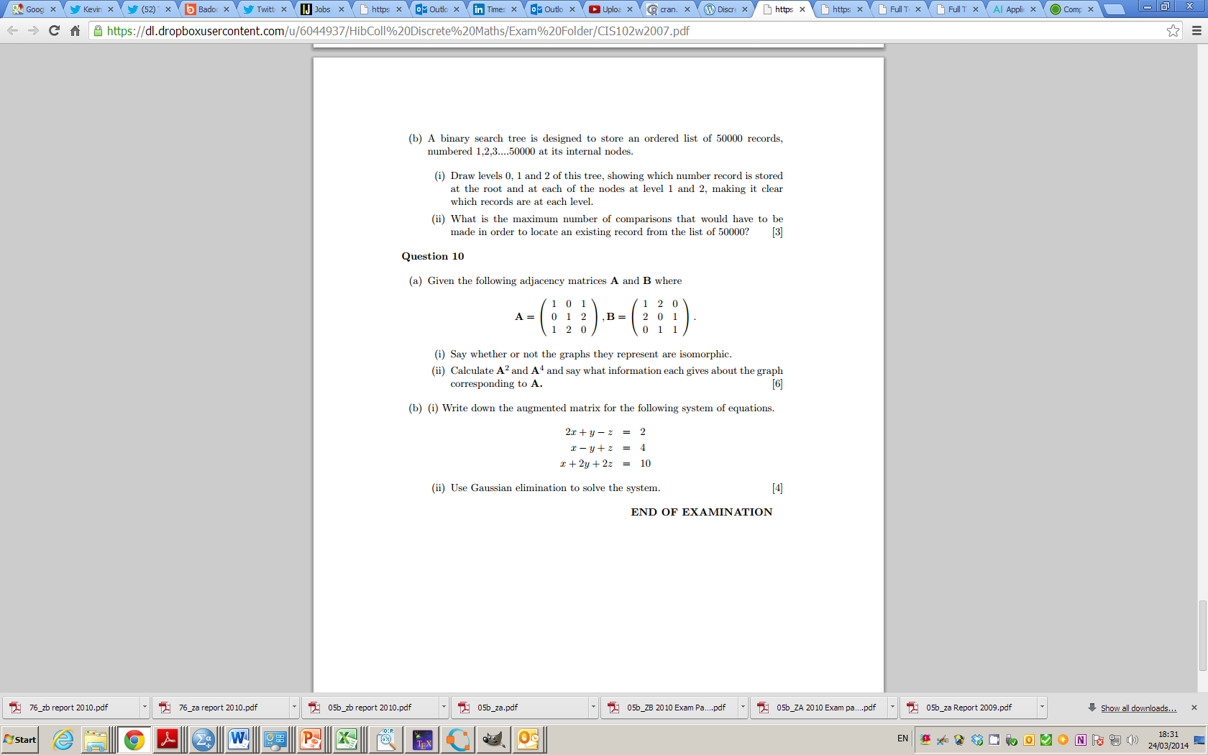
2008 Question 10

Slide 17
2008 Question 10

Slide 18
2008 Question 10

Slide 19
2009 Zone A Question 10

Slide 20
2009 Zone A Question 10

Slide 21
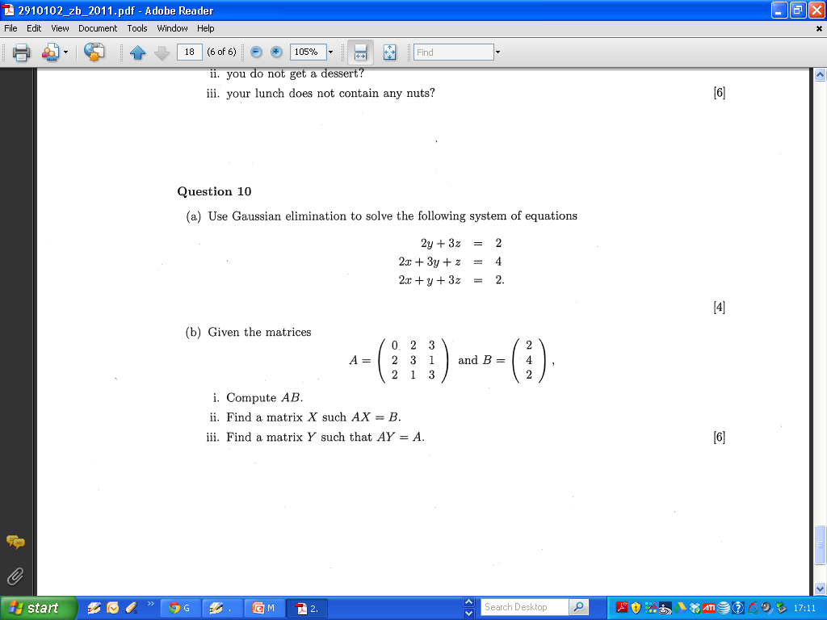
2011 Q 10 Zone B Part A

Slide 22
2011 Q 10 Zone B Part A

Slide 23
2011 Q 10 Zone B Part A

Slide 24
2011 Q 10 Zone B Part A

Slide 25
2011 Q 10 Zone B Part b

Slide 26
2011 Q 10 Zone B Part b

Slide 27
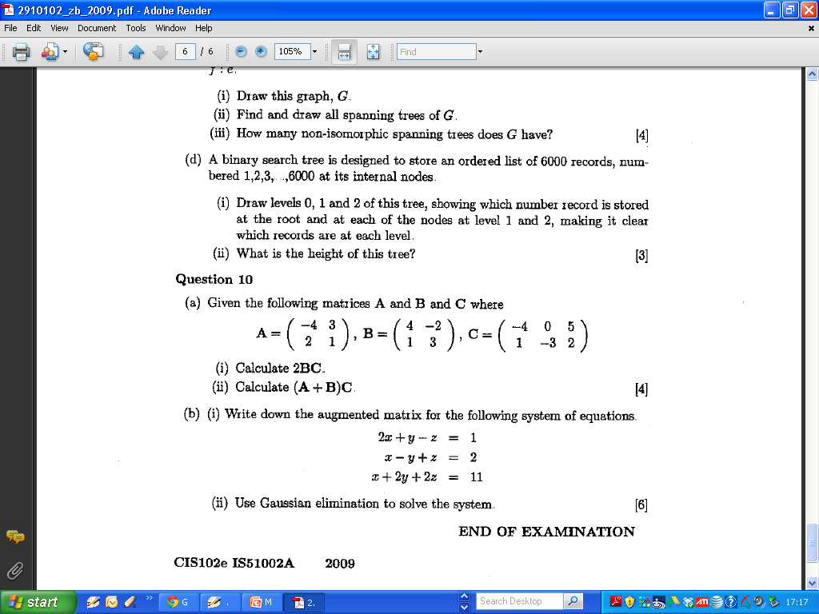
2009 Zone B Question 10 Part A

Slide 28
2011 Q 10 Zone B Part b

Slide 29
2011 Q 10 Zone B Part b

Slide 30
2009 Zone B Question 10 Part A

Slide 31
2009 Zone B Question 10 Part A

Slide 32
2009 Zone B Question 10 Part A

Slide 33
2009 Zone B Question 10 Part A

Slide 34
2009 Zone B Question 10 Part A

Slide 35
2009 Zone B Question 10 Part B

Slide 36
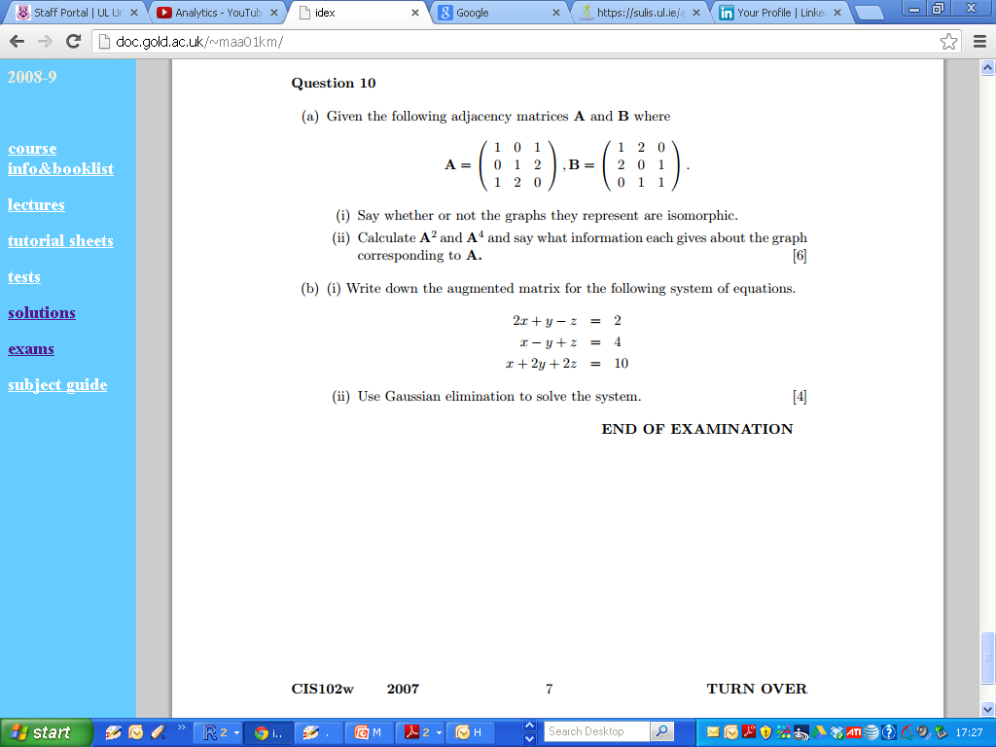
2007 Zone B Question 10 Part A

Slide 37
2007 Zone B Question 10 Part A

Slide 38
2007 Zone B Question 10 Part A

Slide 39
2007 Zone B Question 10 Part A

Slide 40
2007 Zone B Question 10 Part A

Slide 41
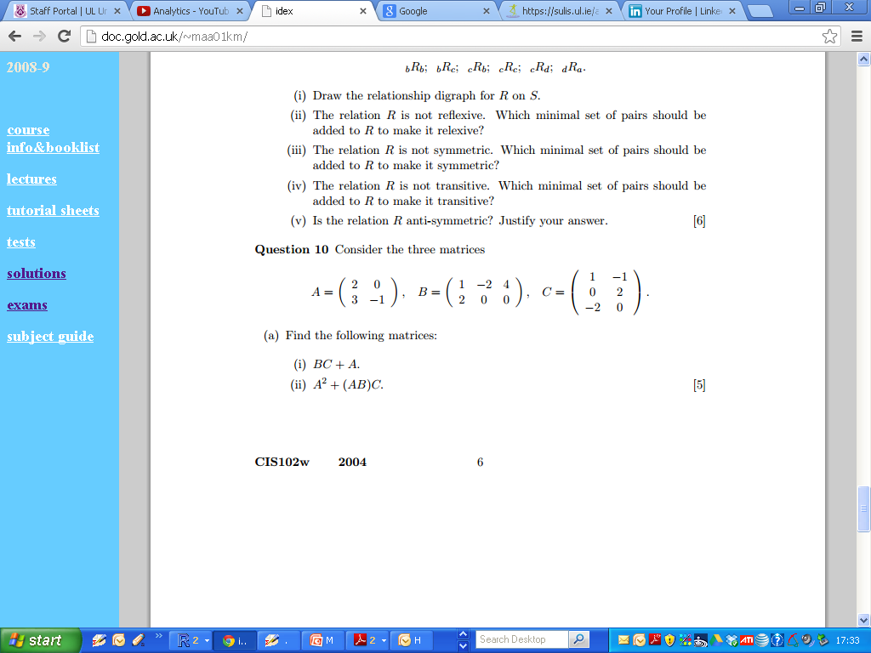
2004 Q 10 Zone B Part A

Slide 42
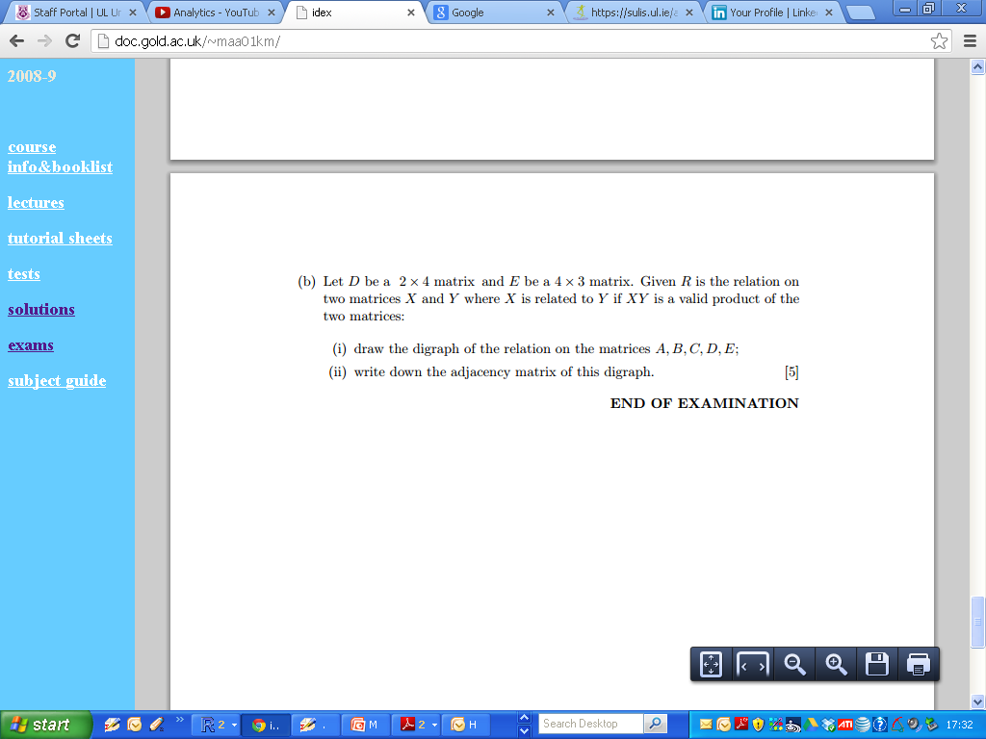
2004 Q 10 Zone B Part A

Slide 43
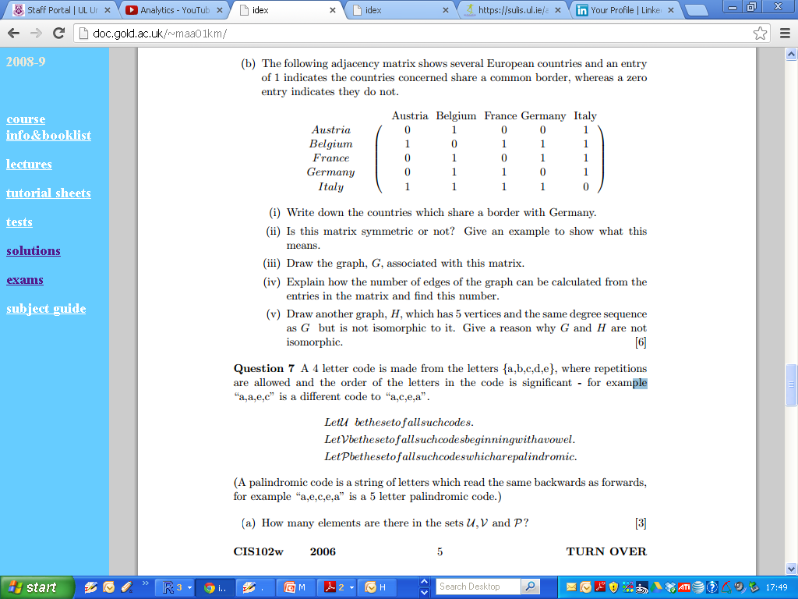
2006 Zone B Q7

Slide 44
2006 Zone B Q7

Slide 45
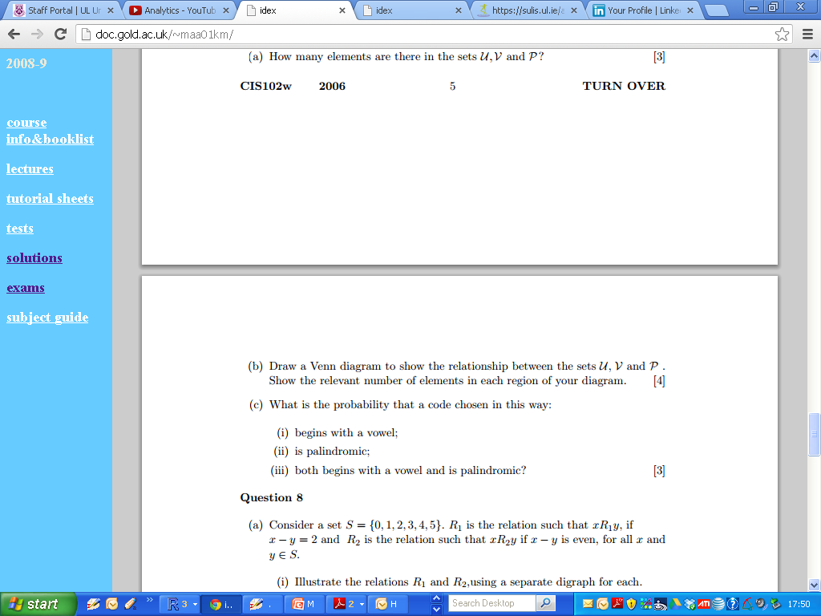
2006 Zone B Q7

Slide 46
2006 Zone B Q7

Slide 47
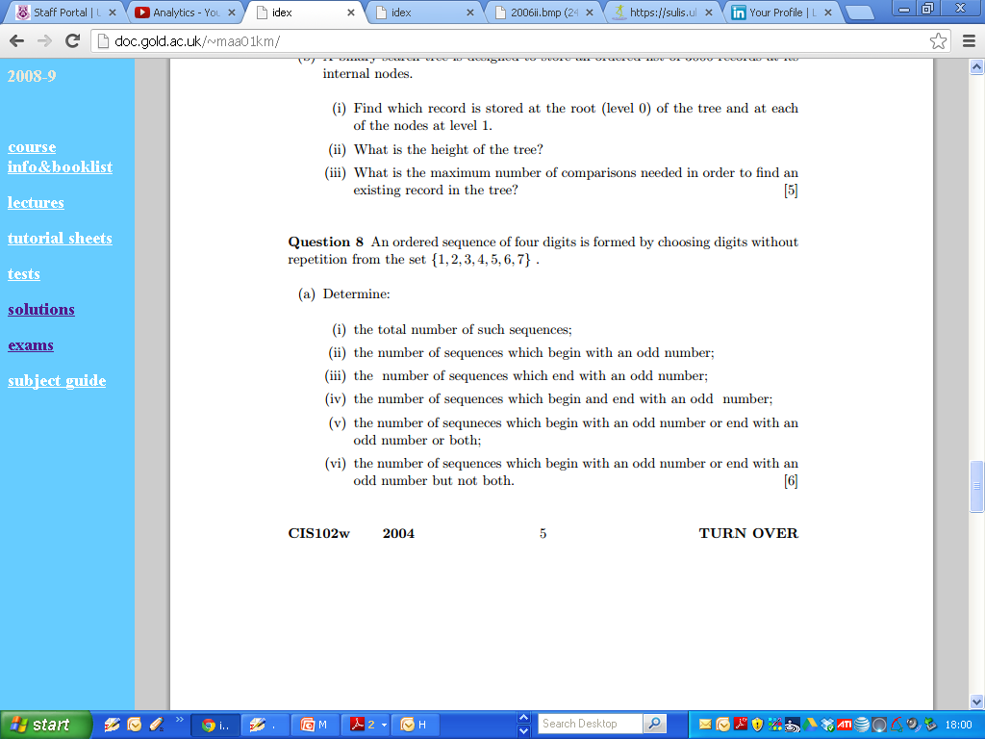
2004 Question 8

Slide 48
2004 Question 8

Slide 49
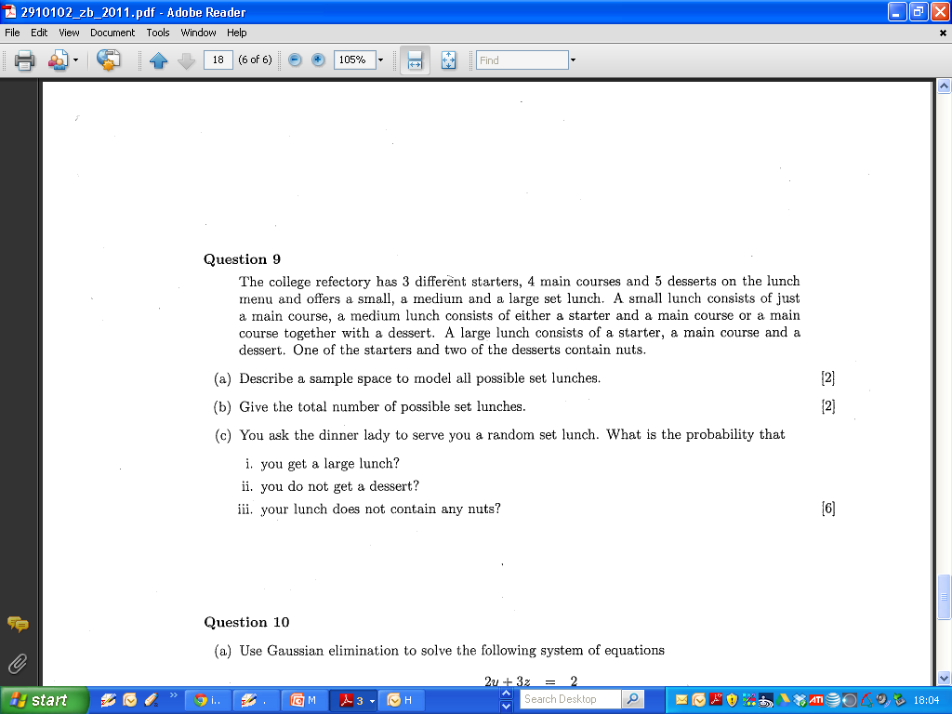
2011 Question 9

Slide 50
2011 Question 9

Slide 51
2011 Question 9

Slide 52
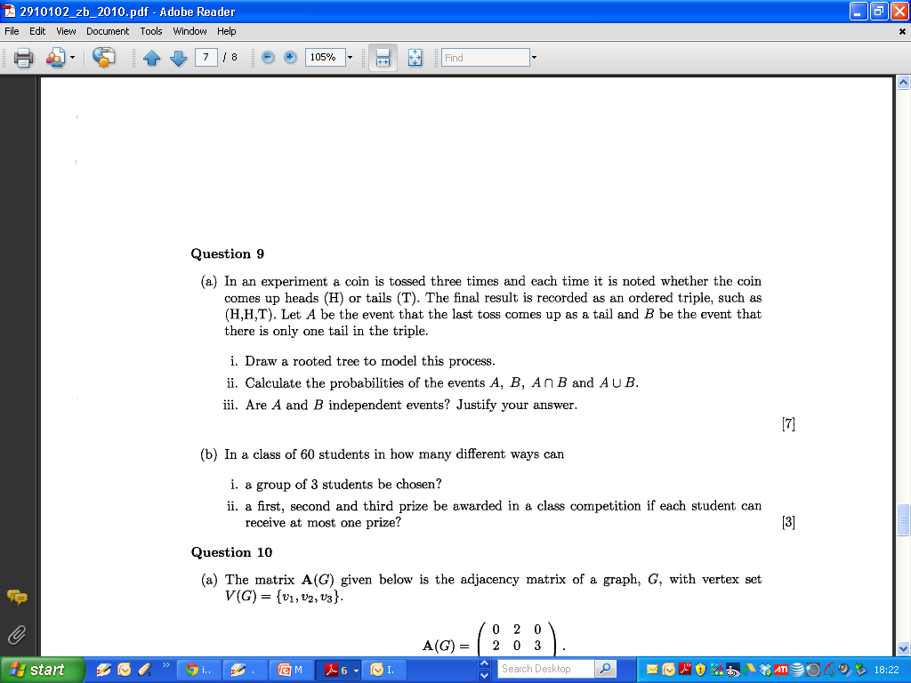
2010

Slide 53
2010 Zone B

Slide 54
2010 Zone B

Slide 55
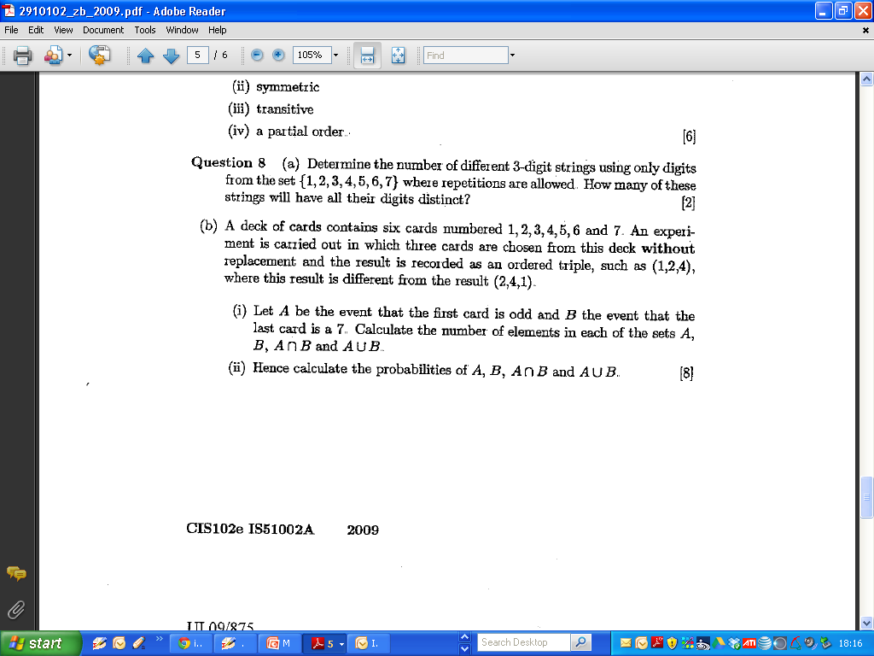
2009 Zone B

Slide 56
2009 Zone B

Slide 57
2009 Zone B

Slide 58
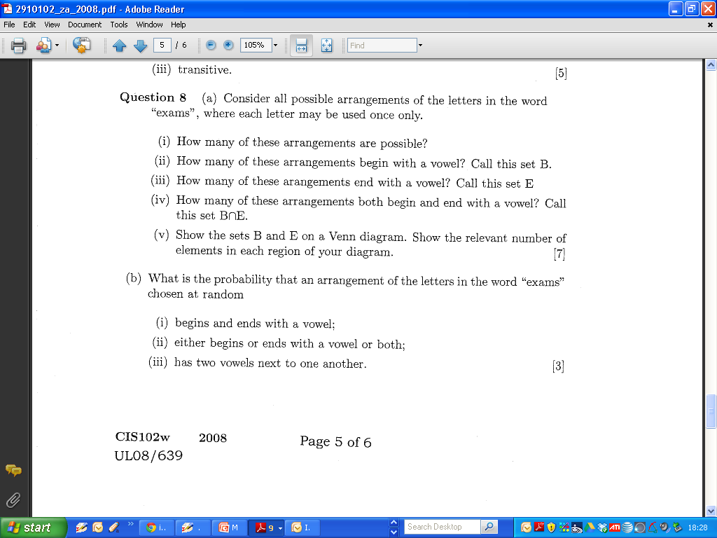
2008 Zone A

Slide 59
2008 Zone A

Slide 60
2008 Zone A

